Slide 1
Sidemeeting in IETF-122 @ Bangkok, Thailand Large-Scale Satellite IP Networks Peng Liu & Tianji Jiang March. 19, 2024

Slide 2
IETF Note Well https://www.ietf.org/about/note-well/
This is a reminder of IETF policies in effect on various topics such as patents or code of conduct. It is only meant to point you in the right direction. Exceptions may apply. The IETF's patent policy and the definition of an IETF "contribution" and "participation" are set forth in BCP 79; please read it carefully.
As a reminder:
By participating in the IETF, you agree to follow IETF processes and policies.
If you are aware that any IETF contribution is covered by patents or patent applications that are owned or controlled by you or your sponsor, you must disclose that fact, or not participate in the discussion.
As a participant in or attendee to any IETF activity you acknowledge that written, audio, video, and photographic records of meetings may be made public.
Personal information that you provide to IETF will be handled in accordance with the IETF Privacy Statement.
As a participant or attendee, you agree to work respectfully with other participants; please contact the ombudsteam (https://www.ietf.org/contact/ombudsteam/) if you have questions or concerns about this.
Definitive information is in the documents listed below and other IETF BCPs. For advice, please talk to WG chairs or ADs:
BCP 9 (Internet Standards Process)
BCP 25 (Working Group processes)
BCP 25 (Anti-Harassment Procedures)
BCP 54 (Code of Conduct)
BCP 78 (Copyright)
BCP 79 (Patents, Participation)
https://www.ietf.org/privacy-policy/ (Privacy Policy)
IETF-122, Large-Scale Satellite IP Networks

Slide 3
Note to all
Open to all
Meeting will be recorded, and all attendees have agreed
Not under NDA of any form
Please list your name and affiliation in the chat feature of webex(or Etherpad) during meeting
Discussions at the end of all presentations
Meeting link: https://ietf.webex.com/meet/ietfsidemeeting3
Github: https://github.com/IETF-Satellite-Networks/side-meeting-IETF122
IETF-122, Large-Scale Satellite IP Networks

Slide 4
Meeting Scope
Revolve around network-layer related issues upon using the large-scale satellite constellation network for TN-NTN integration, i.e. Large scale LEO satellite for internet access or mobile back haul.
Use cases, problems, requirements, challenges & considerations
Addressing, Routing and switching
TN-NTN integration
Practice & Analysis: simulation, real-testing, etc.
Noting
Transport-based solutions is out of scope (of this sidemeeting)
TVR: TVR is to define information and data models that address time-based, scheduled changes to a network.
RTGWG is rechartering as one of the potential direction, we will coordinate with RTGWG and welcome any suggestions and guidance from the community

Slide 5
Meeting Scope
Revolve around any networking related issues upon using the large-scale satellite constellation network for TN-NTN integration, i.e. Large scale LEO satellite for internet access or mobile back haul.
Use cases, problems, & challenges
Addressing, Routing and switching,
Integration with internet (TN-NTN)
Practice & Analysis: simulation, real-testing, etc.
Noting
Transport-based solutions is out of scope
TVR: TVR is to define information and data models that address time-based, scheduled changes to a network.
RTGWG is rechartering to consider more potential directions, we will coordinate with RTGWG and welcome any suggestions and guidance from the community
IETF-122, Large-Scale Satellite IP Networks

Slide 6
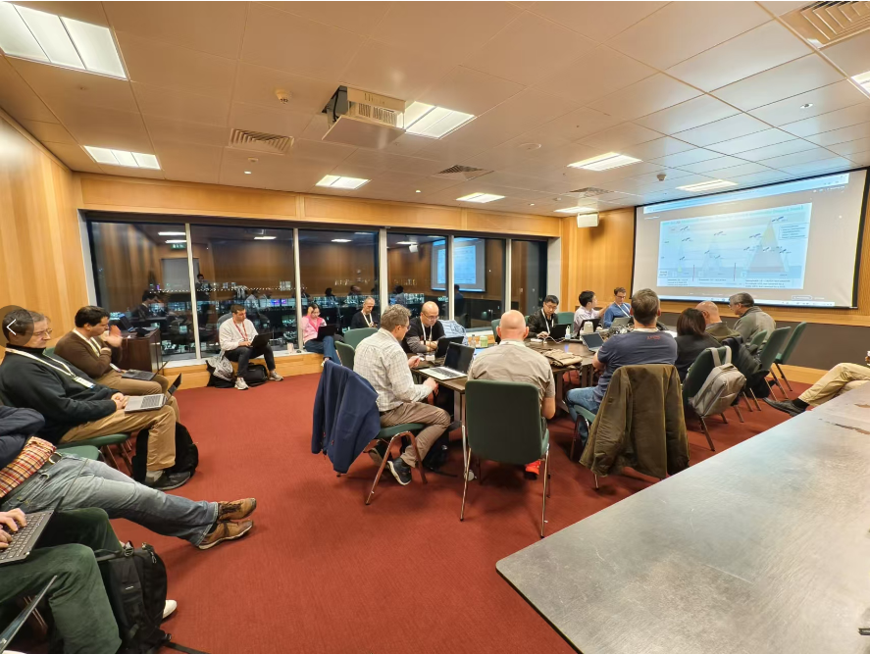
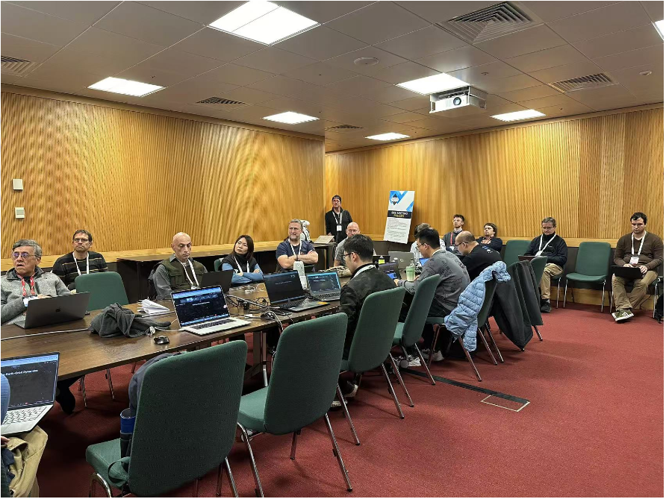
Side meeting in IETF121
Chair's slides
3GPP Satellite Use Cases: Update, Progress & Challenges, China Mobile, Tianji Jiang
Stable hierarchical addressing & routing for operational satellite networks, Tsinghua University, Xin Li
Potential challenges in Non-Terrestrial networks, Huawei (Canada), Arashmid Akhavain.
Energy-efficient temporal connectivity over LEO satellite constellations, Lancaster University, Daniel King
Routing in LEO Sat Nets – A case study on Starlink & OneWeb, U-of-Victoria, Jianping Pan
Discussions and next steps
IETF-122, Large-Scale Satellite IP Networks

Slide 7
Agenda
Slot | Start | Duration | Information | Presenter
1 | 09:30 | 5 mins | Title: Meeting admin | Peng Liu (China Mobile)
2 | 09:35 | 10 mins | Title: Use case and Problem Statement Draft: draft-lj-rtgwg-sat-routing-consideration | Tianji Jiang (China Mobile)
3 | 09:45 | 15 mins | Title: A Routing Architecture for Satellite Networks Draft: RFC 9717 A Routing Architecture for Satellite Networks | Tony Li (Juniper)
4 | 10:00 | 15 mins | Title: Satellite Ground Routing Architecture Based on Access Satellite Prediction Draft: draft-hou-rtgwg-satellite-ground-routing | Xiao Min (ZTE)
5 | 10:15 | 15 mins | Title: Routing in space-air-ground-integrated networks | Jianping Pan (University of Victoria)
6 | 10:30 | 15 mins | Title: A Resilient Routing Algorithm for Handling K-Link/Node Failure in Inclined LEO Megaconstellations | Kanglian Zhao (Nanjing University)
7 | 10:45 | 5mins | Title: Geographical Addressing: A vehicle to address scalability in LEO Networks | Arashmid Akhavain (Huawei)
8 | 10:50 | 10 mins | Open Discussion | All
IETF-122, Large-Scale Satellite IP Networks

Slide 8
Discussions
Is the problem scope well defined?
Network-layer centric
Do we need further work to explore the problem?
How about existing WGs and their implications?
Transport-level optimization
DTN, MANET, TIPTOP, potential space RG, etc.
Follow-up:
coordinate with RTGWG
side meeting or BoF?

